Slide 1
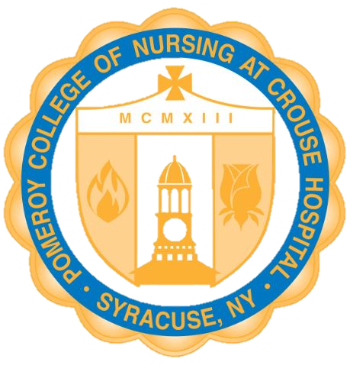
Student Consumer Information
Measures of Student Achievement
NCLEX-RN Pass Rate
Percentage of graduates who passed the NCLEX-RN licensing examination on the first attempt.
 | 2025 | 2024 | 2023
Pomeroy College of Nursing at Crouse Hospital | 95% | 98% | 86%
New York State Average | 82% | 88% | 84%
National Average | 87% | 91% | 89%
Job Placement Rate
Percentage of graduates who obtained a RN position within 12 months of graduation.
Retention Rate
Percentage of original cohort who returned for the second year of study.
2024 | 92%
2023 | 100%
2022 | 99%
Cohort entering 2024 | 80%
Cohort entering 2023 | 81%
Cohort entering 2022 | 82%
Program Completion Rate
Percentage of graduates who completed the program within 100% of the stated program length. (Benchmark/Goal = 50%)
2023 | 56%
2022 | 47%
2021 | 48%

